Slide 1
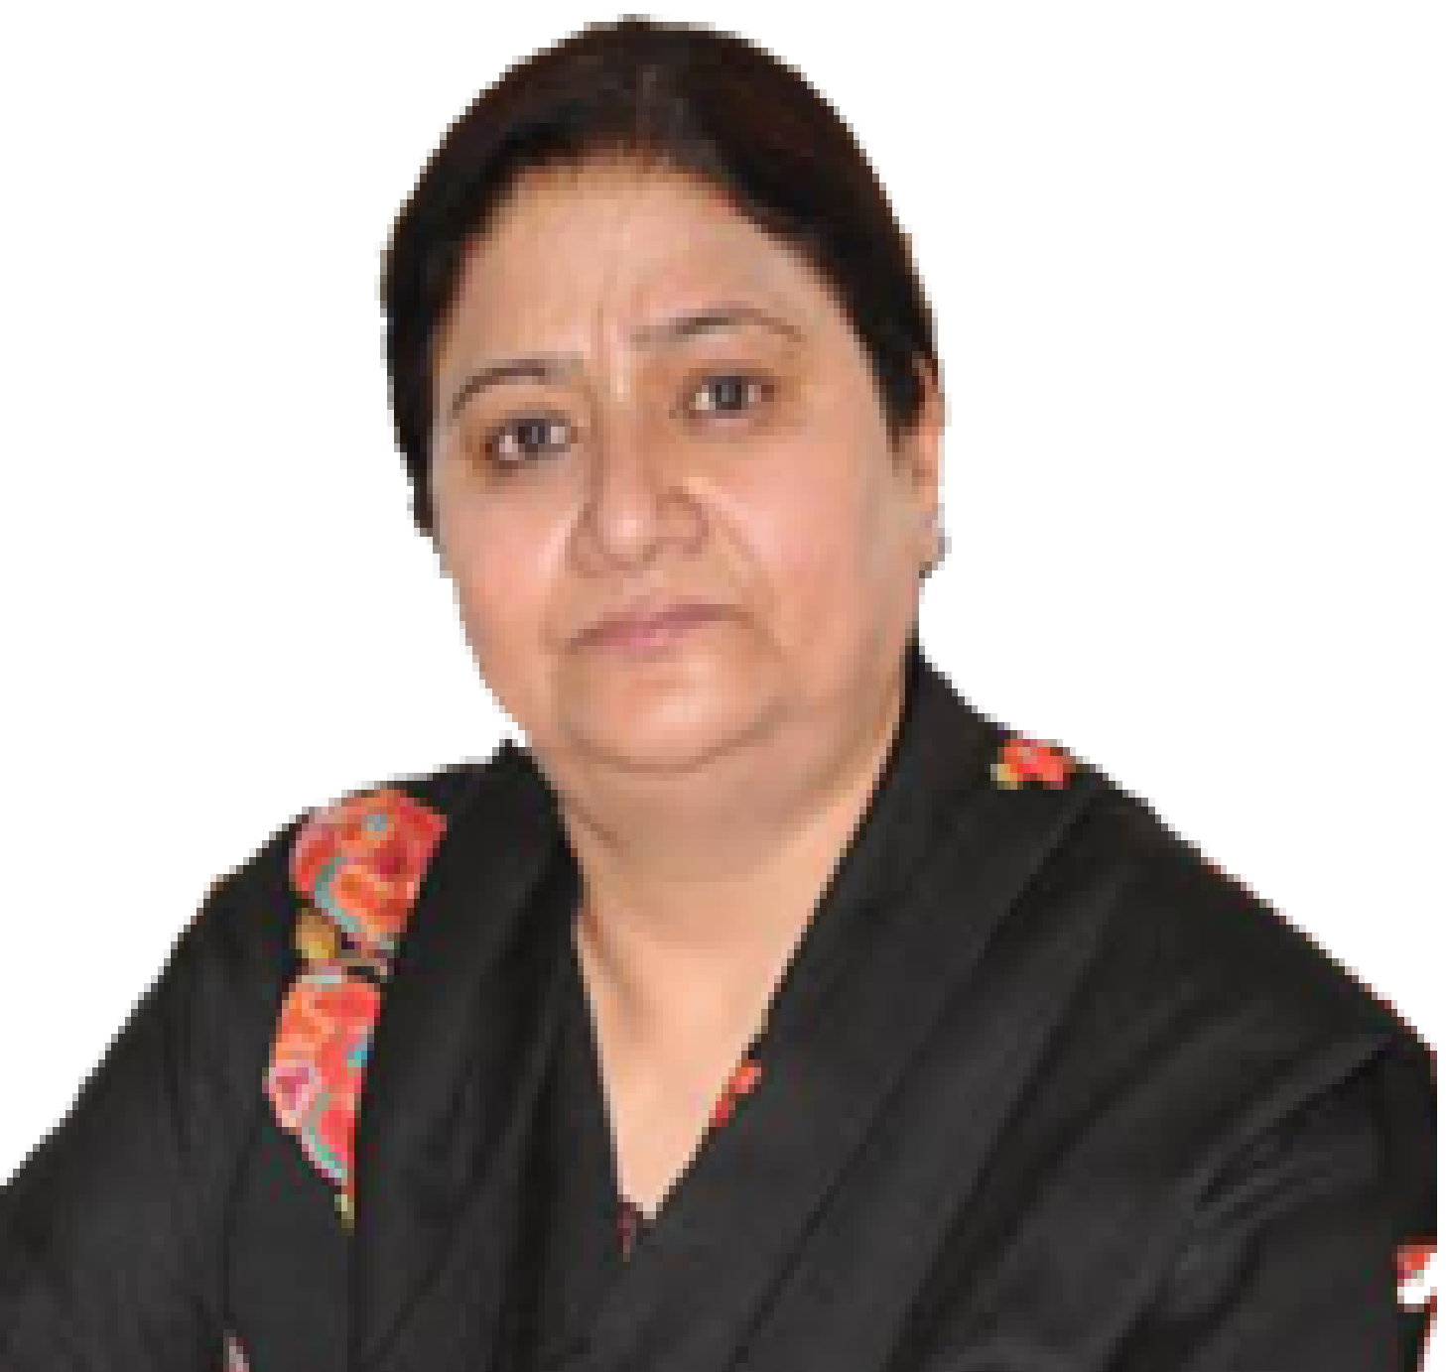
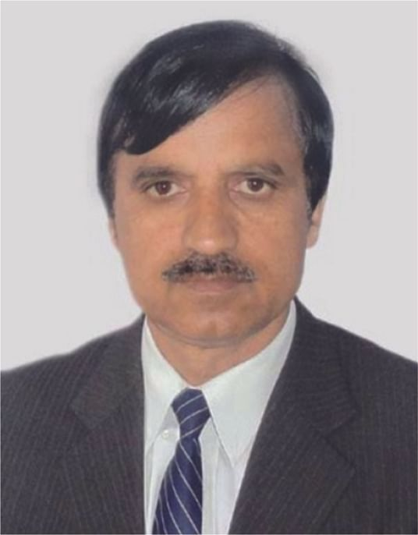
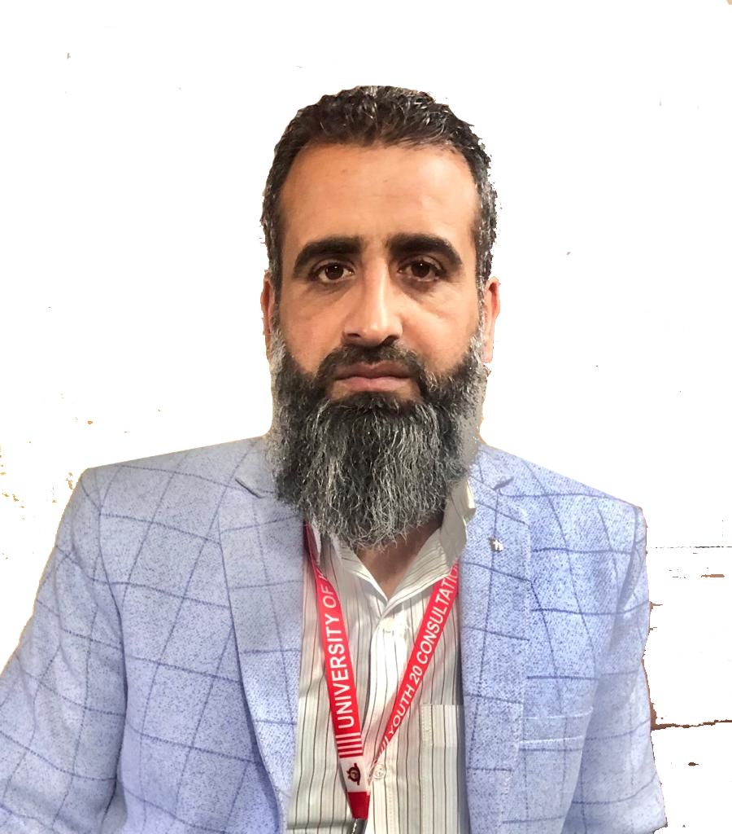
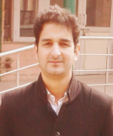
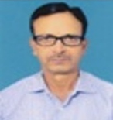
Valedictory Session
Refresher Course in Human Rights (Interdisciplinary) 31st Jan to 13th Feb 2024
Organized by
UGC-Malaviya Mission Teacher Training Centre
University of Kashmir
(NAAC Accredited A+)
Prof. Nilofer Khan
Chief Guest
Honorable Vice Chancellor
University of Kashmir
UGC-Human Resource Development Centre, University of Kashmir (uok.edu.in)
Prof. Mushtaq Ahmad Darzi
Director, UGC-MMTTC
University of Kashmir
Dr. Karatar C Sharma
Coordinator, UGC-MMTTC
University of Kashmir
Dr. Faheem Syeed Masoodi
Coordinator, UGC-MMTTC
University of Kashmir
Dr. Junaid Alam Mir
Department of Law, University of Kashmir
Course Coordinator

